Slide 1

IPL 2008-2019
A Tableau Project by
Priyanki Das
Batch –GCD 16-10-2019

Slide 2
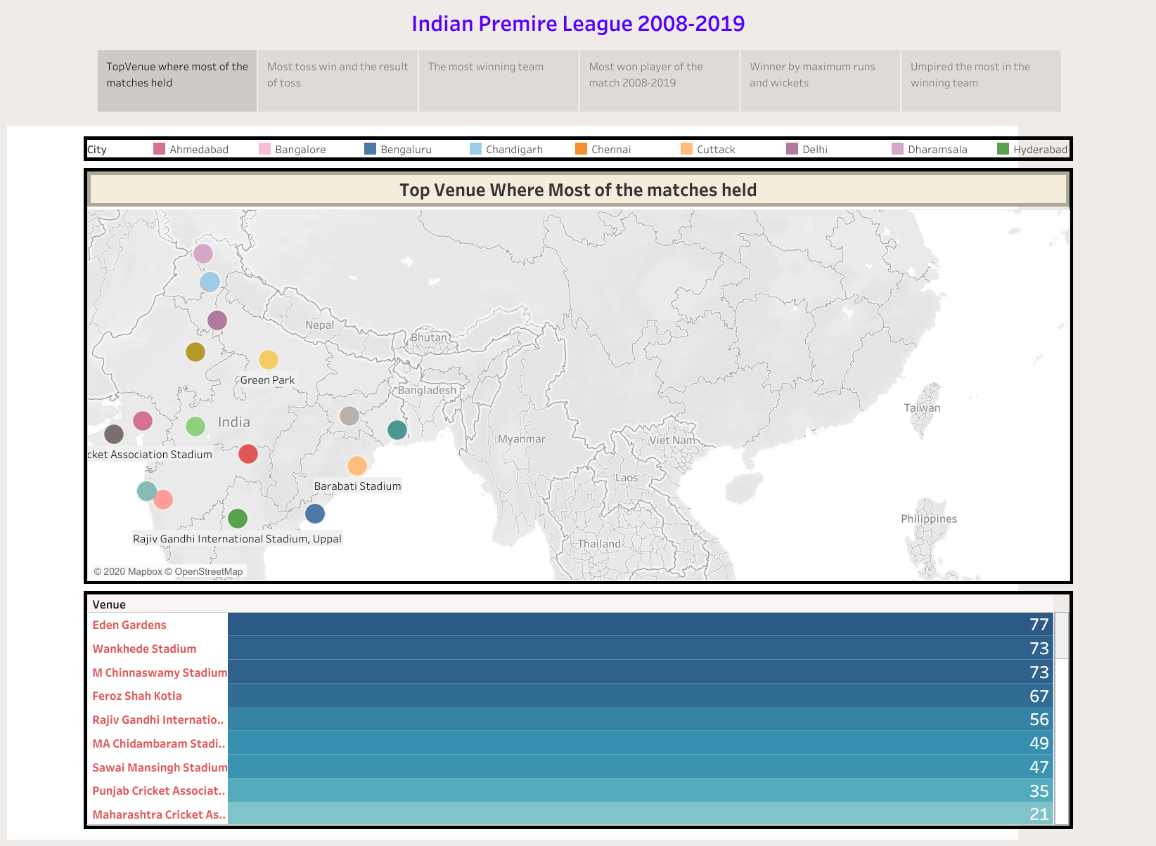
Here we can see the highest number of IPL matches were played in Eden Gardens Kolkata

Slide 3
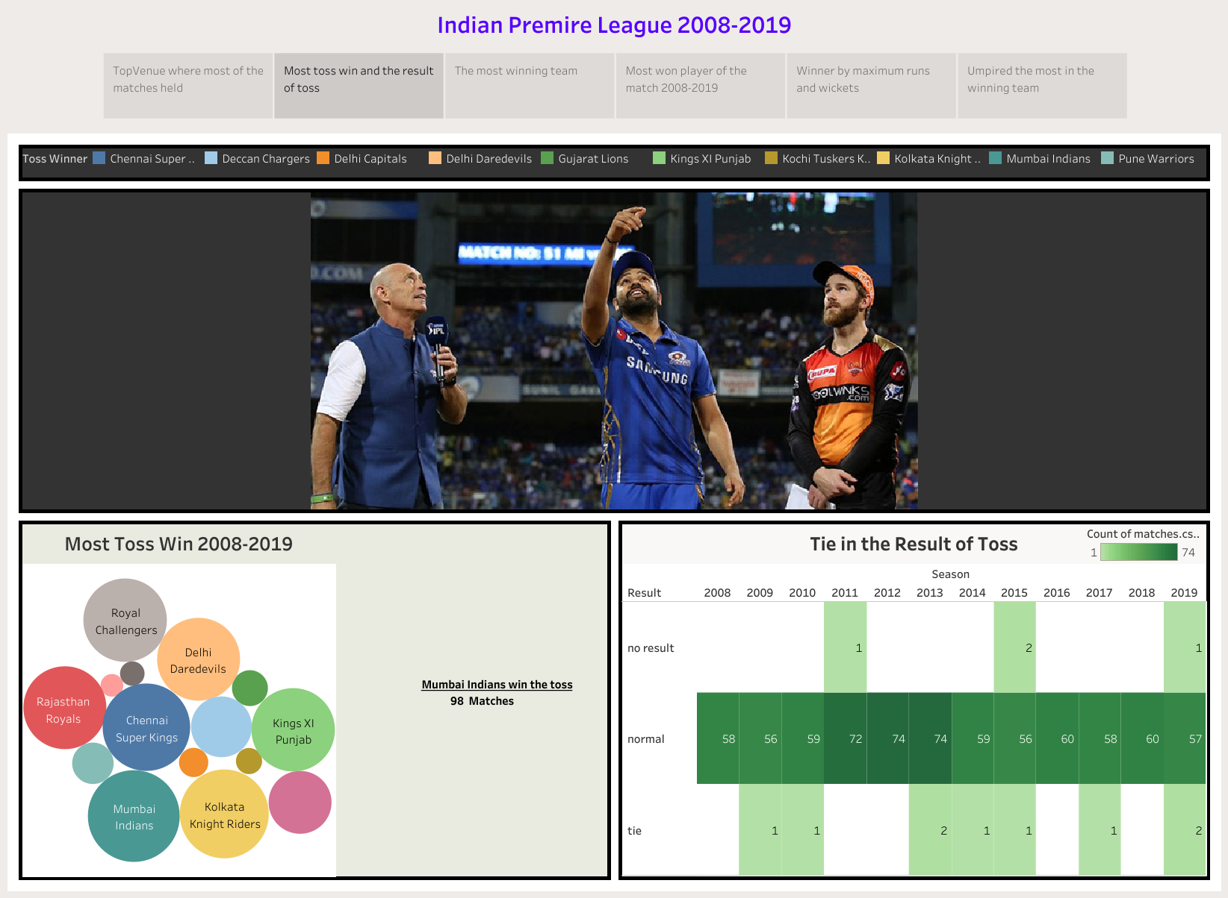
Toss was won by Mumbai Indians in most of the match .While toss it can be seen 9 times came out to be a tie in all these years.

Slide 4
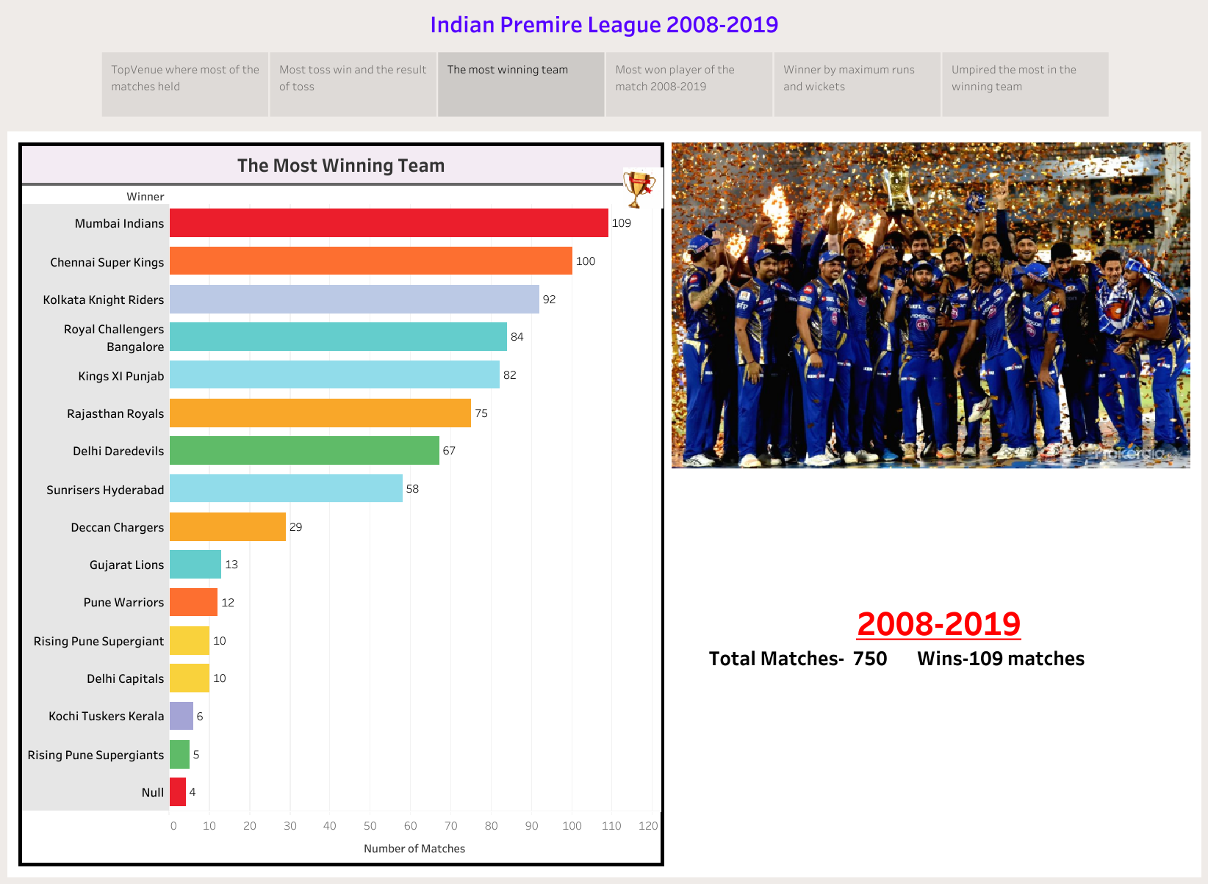
Here we can see the highest number of winning team is Mumbai Indians i.e 109 matches from 750 .

Slide 5
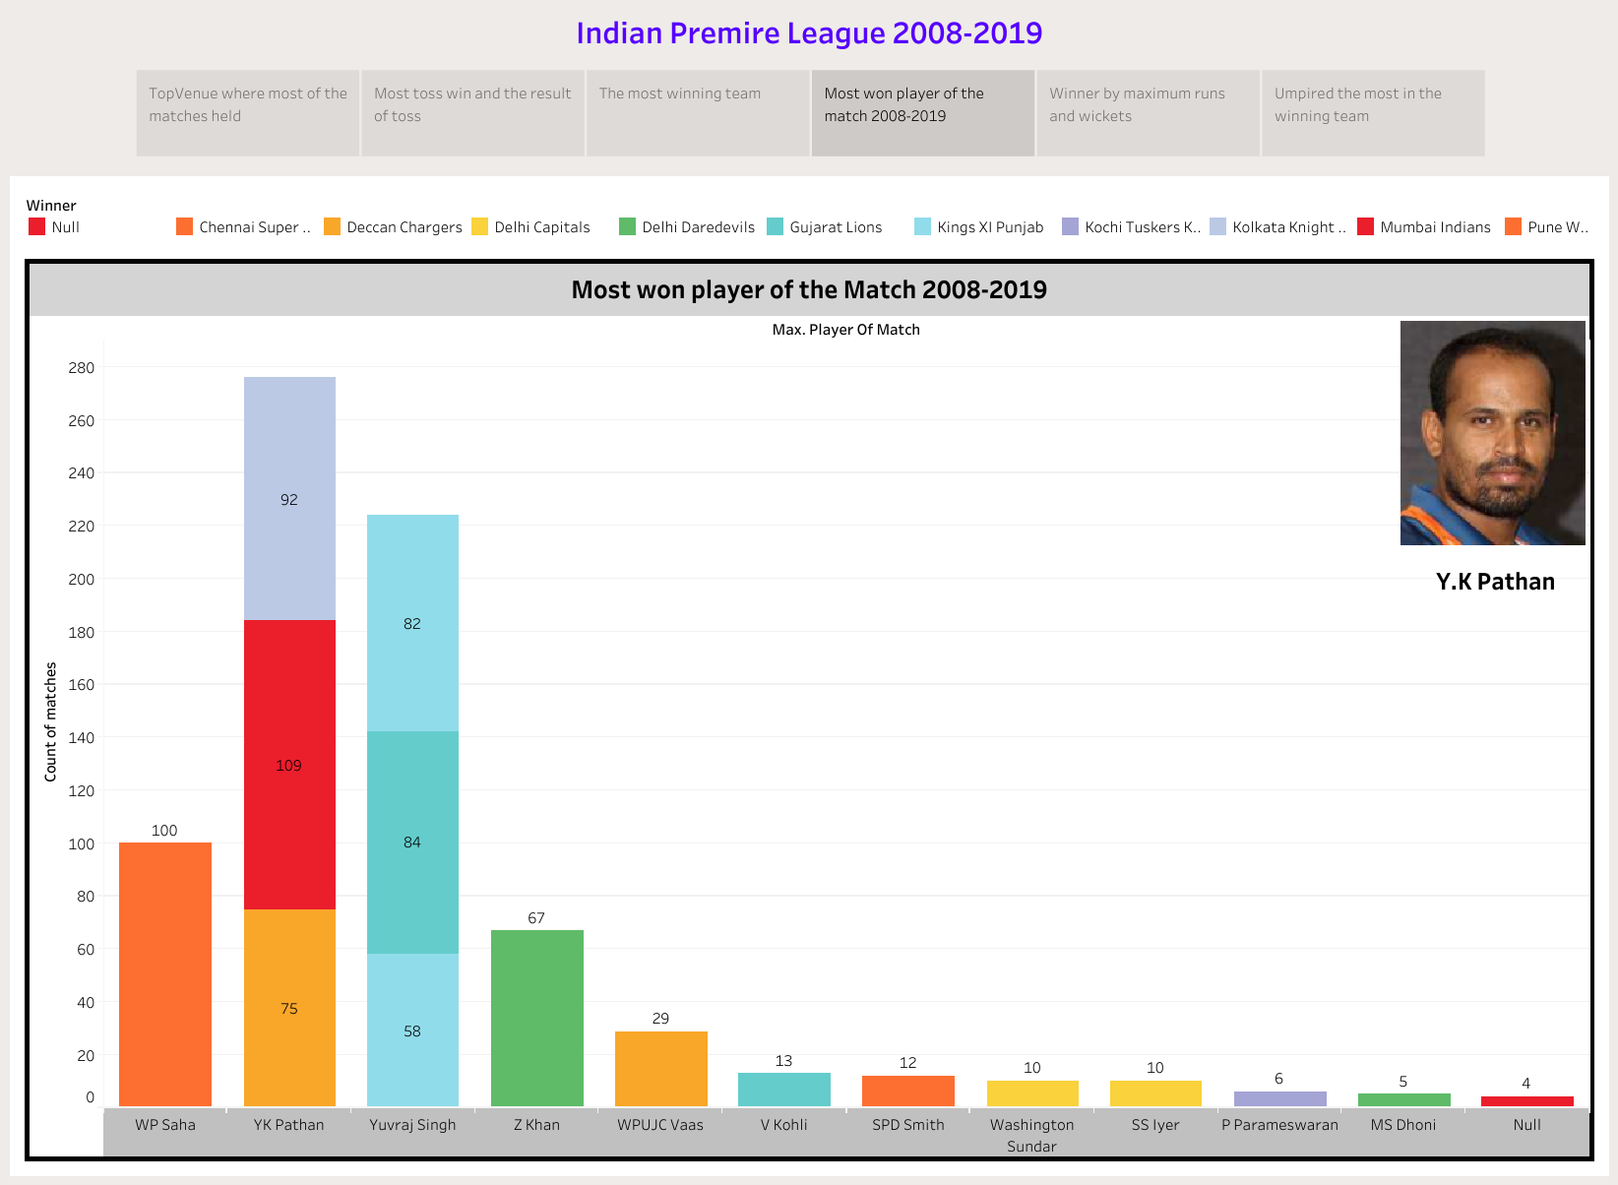
The man of the match was won by Yusuf Pathan in greatest number of times between 2008-2019.

Slide 6
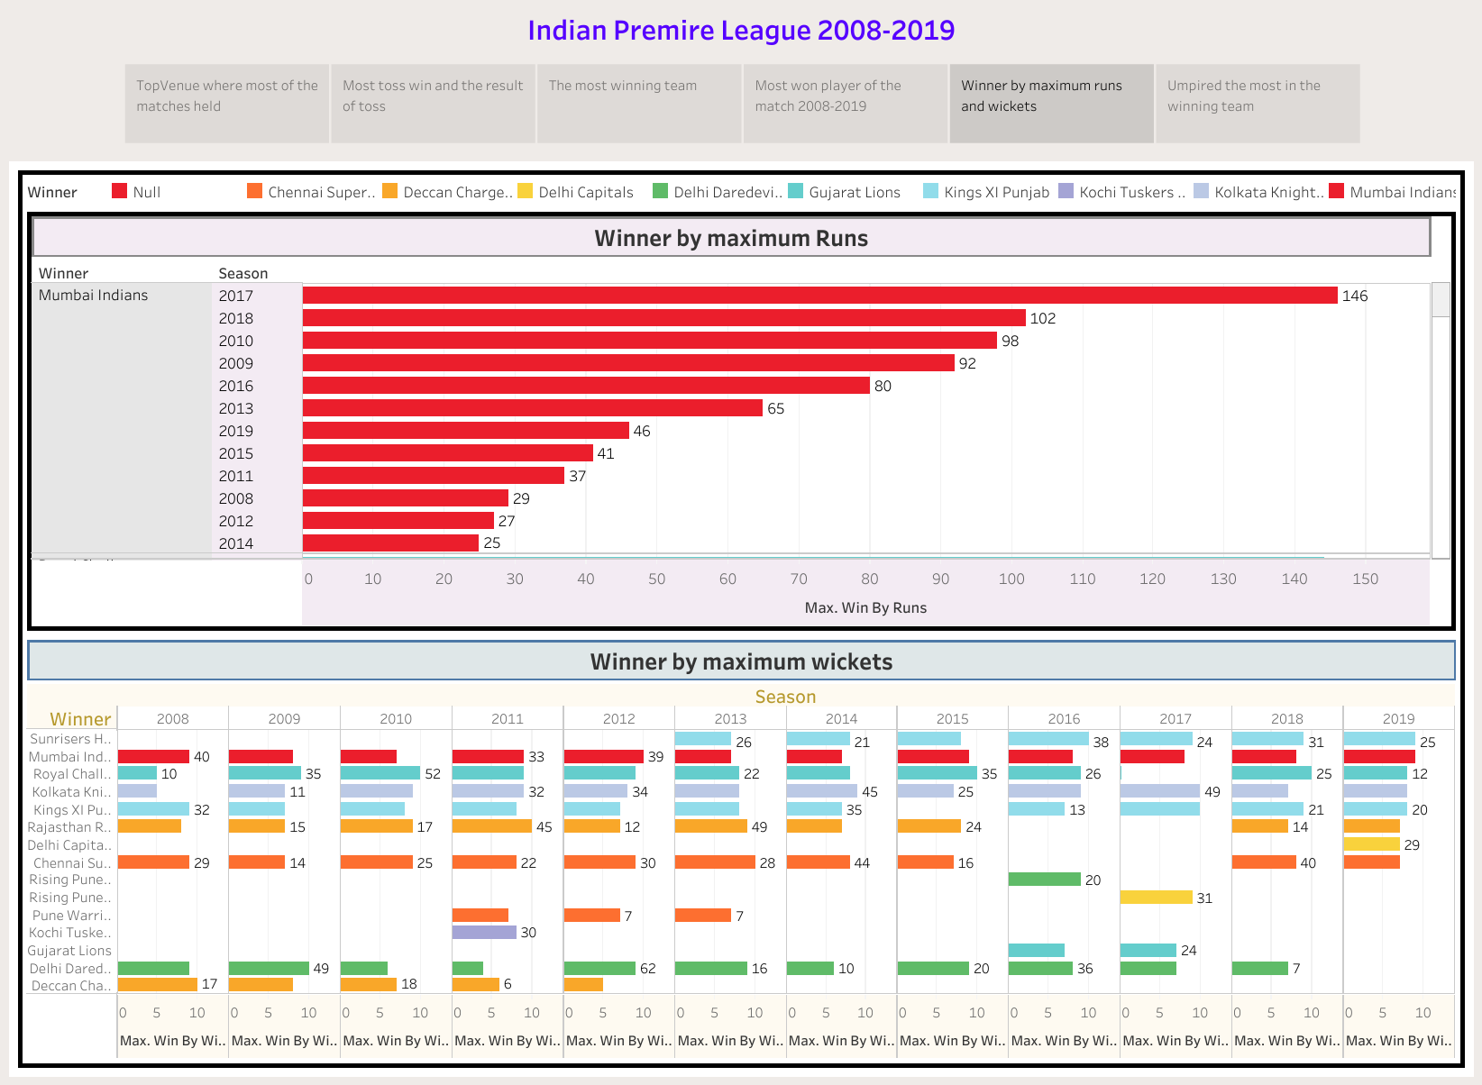
Here we observe ,the winner by maximum runs is in 2017 by Mumbai Indians by 146 as well as Mumbai Indians is the team who won by maximum wickets in 2008.

Slide 7
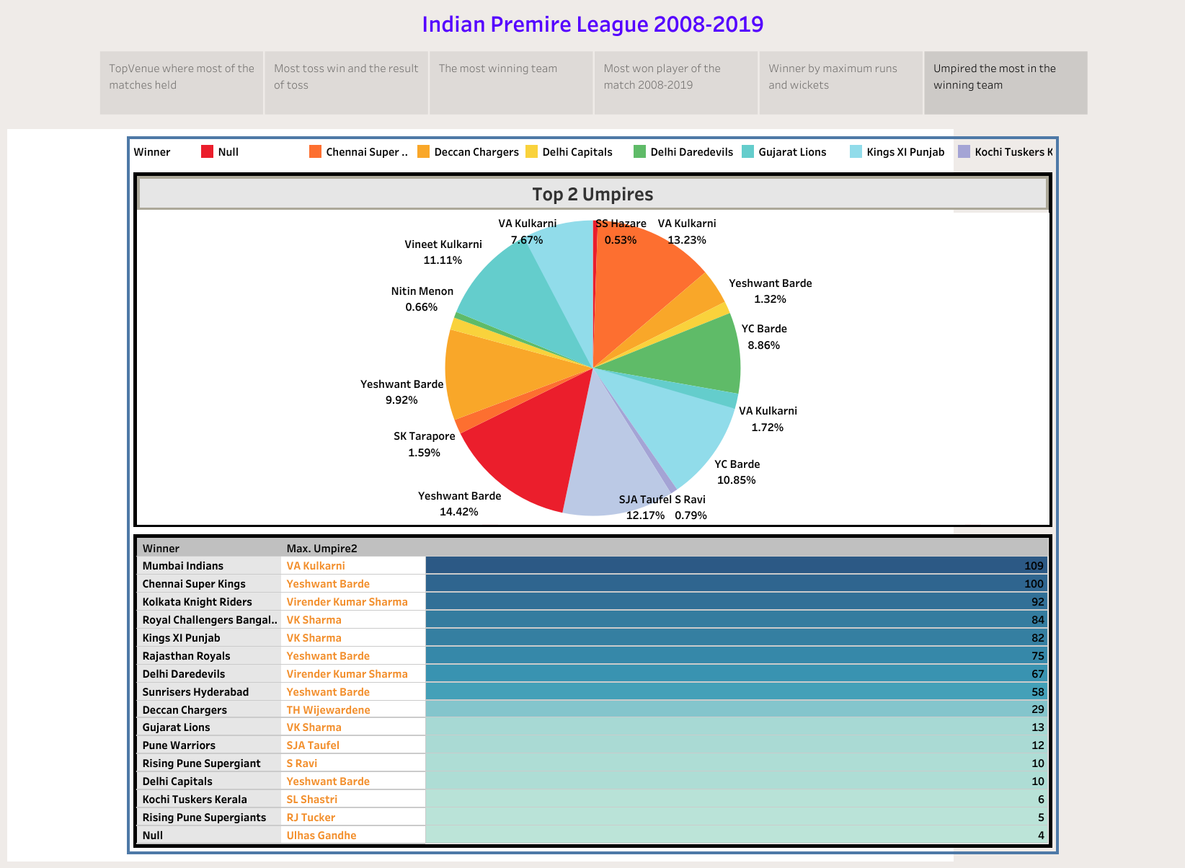
From the above pie chart we can see Yashwant Barda followed by V.A Kulkarni which can be seen in the 2nd chart ,umpired in most of the matches where Mumbai Indians is the winning team.

Slide 8
THANK YOU

